Slide 1
A Model-Agnostic Approach to Quantifying the Informativeness of Explanation Methods for Time Series Classification
Thu Trang Nguyen, Thach Le Nguyen, Georgiana Ifrim
School of Computer Science, University College Dublin, Ireland
Notes:
What, why important, key contribution ideas
Self introduction, give audience time to adjust and set context to the talk

Slide 2

Introduction
Time Series Classification (TSC)
Prediction task common in many real-life applications, especially Human Activity Recognition tasks; often requires explanation for the algorithm’s prediction
Landing Classes:
Normal
Bending
Stumble
Notes:
Limit to the form of the Explanation: SM
Contrast: classification task vs. Explanation for the algo’s prediction
Importance of explainability: GDPR(user), data bias (data), debug the algo’s bias (algo) - 3 aspects of ML
Essence:
Time Series Classification using machine learning improves tremendously in the recent year and achieves state-of-the-art performance
Used in many applications, many of them requires explanation for critical decision (eg. human activities recognition task).
The explanation often in the form of the saliency maps.
Many technique to produce such maps.
Challenge: how to assess and compare such explanations
In this paper, we present an attempt to address this challenge.

Slide 3
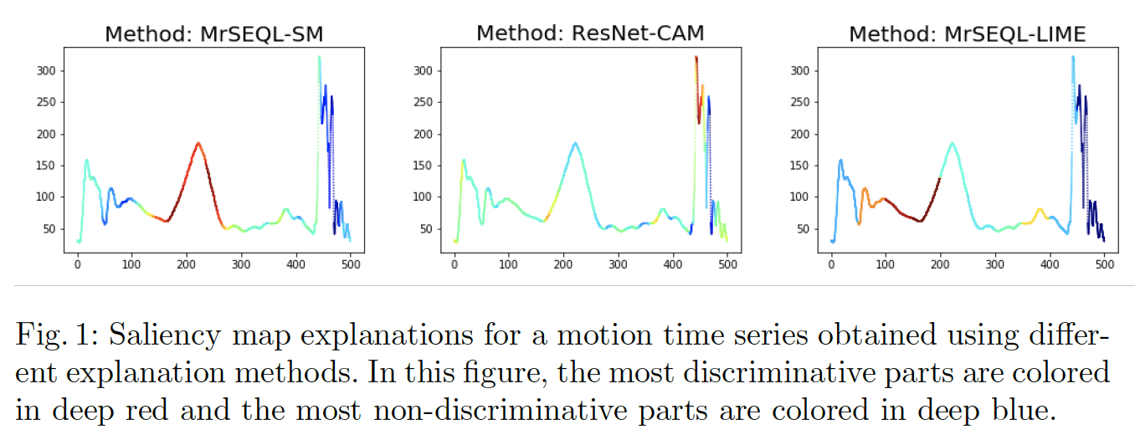
⇒ Challenge: How to assess and objectively compare TSC explanation methods?
Notes:
Can add a gif of a person jumping with a sensor attached to the leg to show visual of the jump movement (Georgiana has this)
The figures here show the acceleration magnitude captured by the sensor
The sensor is a Shimmer3 IMU placed on dominant foot; it streams accelerometer data at 1024 Hz (1024 values per second).

Slide 4
Related Work
We focus on quantitative assessment of explanations for TSC
We use saliency-based explanations produced by the following methods:
MrSEQL-SM: Saliency Map computed from MrSEQL linear classifier weights [2]
CAM: Class Activation Map (explaining FCN/ResNet models) [3]
LIME: Local Interpretable Model-Agnostic Explanations (explaining any models) [1]

Slide 5
Research Methods
Key Concepts:
Explanation as a Saliency Map: produced by matching a time series with a vector of weights (explanation) using a heatmap → highlight the discriminative parts of the time series
Referee Classifiers: independent TS classifiers to evaluate the explanation
Explanation Informativeness: via explanation-based data perturbation, a more informative explanation can more effectively impact the referee classifiers predictions
→ Key idea: If the explanation is informative, knocking-off (perturbing) the discriminative parts of the time series leads to lower accuracy for the referee classifier
Notes:
Add a slide with example: original TS, weight vector, SM, percentile, discriminative vs.non-discriminative parts
Change the saliency to [0,100] for consistency with figures
Less than 5 mins for intro and related works

Slide 6
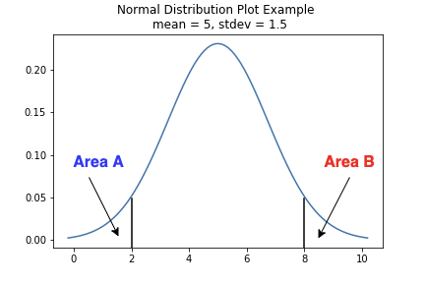
Research Methods
Discriminative vs. Non-discriminative parts of the Time Series
Each time series index has a corresponding saliency weight
Discriminative/Non-discriminative parts: indices of the TS with weights in the top/bottom k% of the entire weight profile.
Example: with k = 20, discriminative parts are the parts of the TS in the top 20% of the weights (index 5 and 6), non-discriminative parts are those that belong in the bottom 20% of the weights (index 1 and 4). The perturbation threshold k varies, eg 0%, 10%, 20%,...,100%.
Index (0-10) | 1 | 2 | 3 | 4 | 5 | 6 | 7 | 8 | 9 | 10
Weight (in range [0,100]) | 9 | 58 | 46 | 15 | 75 | 78 | 57 | 48 | 36 | 17
Notes:
Briefly go through

Slide 7
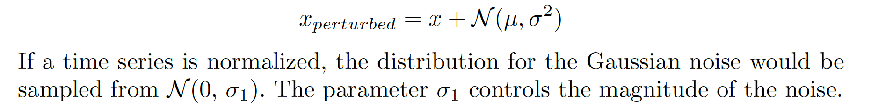
Research Methods
Explanation-driven Data Perturbation
Type1: noise added to only discriminative parts (with different perturbation level k)
Type2: noise added to only non-discriminative parts (with different perturbation level k)
Perturbation: adding Gaussian noise to the original signal
Index | 1 | 2 | 3 | 4 | 5 | 6 | 7 | 8 | 9 | 10
Weight | 9 | 58 | 46 | 15 | 75 | 78 | 57 | 48 | 36 | 17
x | 224 | 420 | 465 | 222 | 257 | 405 | 383 | 439 | 350 | 450
x_{perturbed (type1)} | 224 | 420 | 465 | 222 | 258 | 400 | 383 | 439 | 350 | 450
x_{perturbed (type2)} | 220 | 420 | 465 | 229 | 257 | 405 | 383 | 439 | 350 | 450
For k = 20, we perturb 20% of the time series
Notes:
Add a slide with example: original TS, weight vector, SM, percentile, discriminative vs.non-discriminative parts
the change here seems very tiny, how big should the noise magnitude be to see an effect? I think this question will be asked in the QA

Slide 8
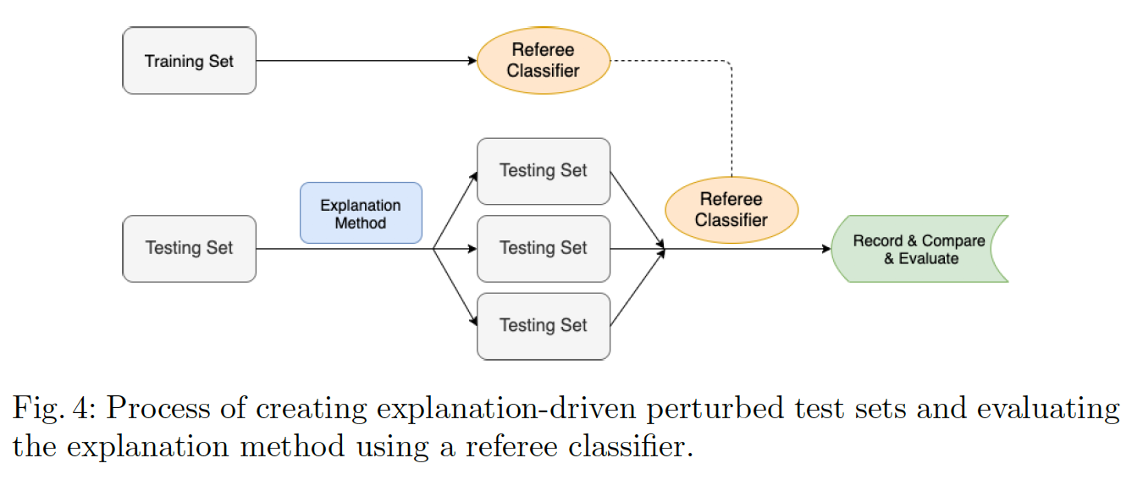
Research Methods
Quantifying the Informativeness of Explanation Methods
Process:
Notes:
Briefly go through. Explain why you have multiple pertubed test set: (because of multiple threshold for each of the perturbation type 1/2)

Slide 9
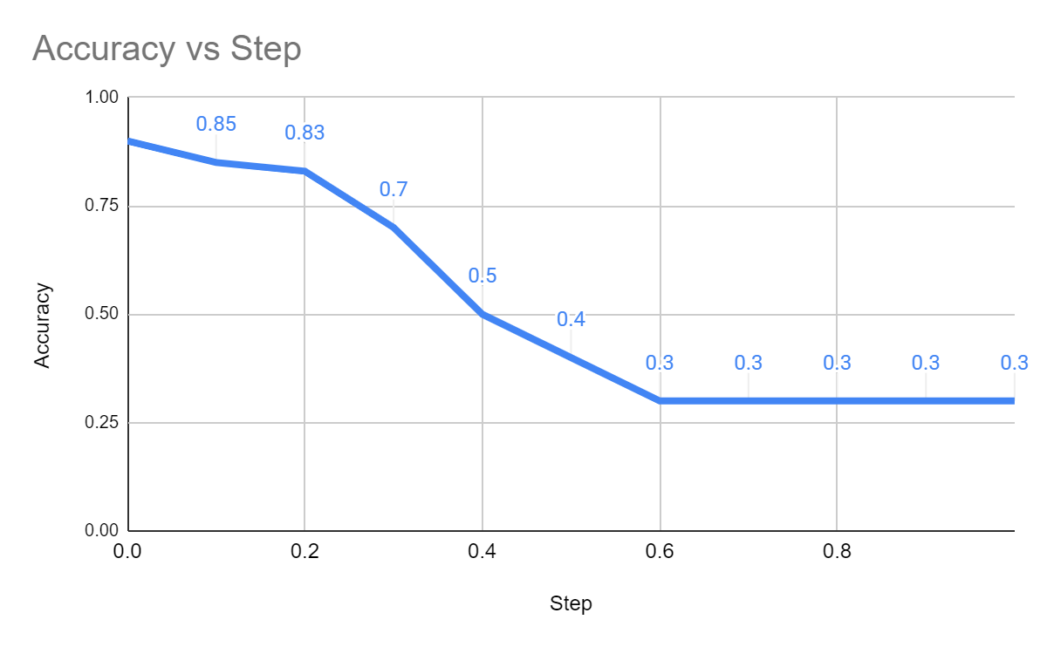
Research Methods
Threshold for discriminative weights | 0% | 10% | 20% | ... | 90% | 100%
Classification accuracy by referee classifier | 0.90 | 0.85 | 0.83 | ... | 0.30 | 0.30
Notes:
Briefly go through. Explain why you have multiple pertuRbed test set: (because of multiple threshold for each of the perturbation type 1/2)
mention here that 0% means no perturbation, 10% means perturb 10% of time series, 100% perturb all time series

Slide 10
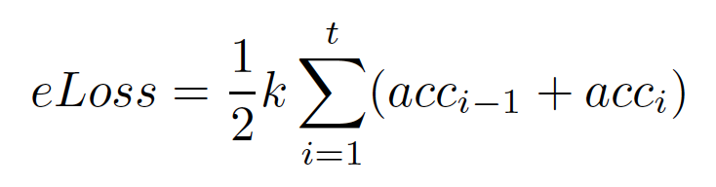
Research Methods
Quantifying the Informativeness of Explanation Methods
Evaluation Measure
Measure the impact of the accuracy reduction induced by different explanation methods by estimating the area under the (explanation-driven) accuracy curve
Method: use trapezoidal rule
Proposed Metric: eLoss
k - value of each step between the 0-1 range
t - number of steps (100/k)
acc_{i} - the accuracy at step i, measured by a referee classifier

Slide 11
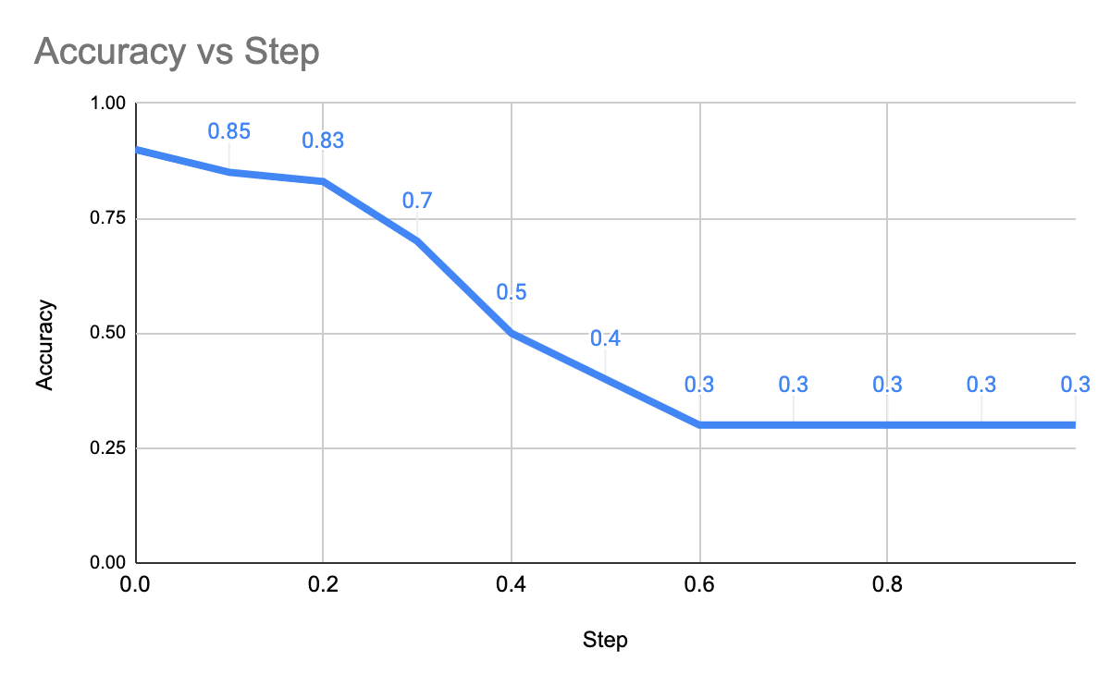
Research Methods
Quantifying the Informativeness of Explanation Methods
Evaluation Measure
Area of the red-bounded trapezoid:
½ k (acc_{previous step} + acc_{this step})
k
Notes:
Add a figure to give context. Annotate the previous figure

Slide 12
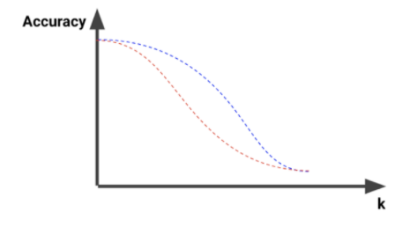
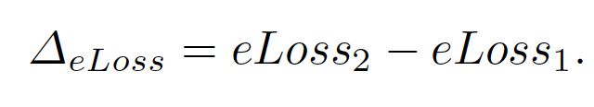
Research Methods
Evaluating Explanations:
One Explanation:
For a set of thresholds from 0-100, identify the discriminative and non-discriminative parts. Perturb these parts of the test time series.
If the explanation method is informative, the accuracy (measured by a referee classifier) drops more when the discriminative parts are perturbed.
Method is informative when Type1 eLoss (eLoss₁) is less than Type2 eLoss (eLoss₂)
ΔeLoss >0:
Figure: Change of accuracy when the test set is perturbed with a threshold k.
Notes:
Explain how we can create this curve: add a table with accuaracies by threshold + type ½ → this figure. Reduce text.

Slide 13
Research Methods
Evaluating Explanations:
Multiple Explanations:
For set of thresholds from 0-100, identify only the discriminative parts. Perturb these parts of the test time series.
Most informative explanation leads to most accuracy drop (measured by a referee classifier), when the discriminative parts are perturbed.
Most informative method has lowest eLoss₁
Compare eLoss₁ of the methods under investigation
Notes:
Explain how we can create this curve: add a table with accuaracies by threshold + type ½ → this figure. Reduce text.

Slide 14
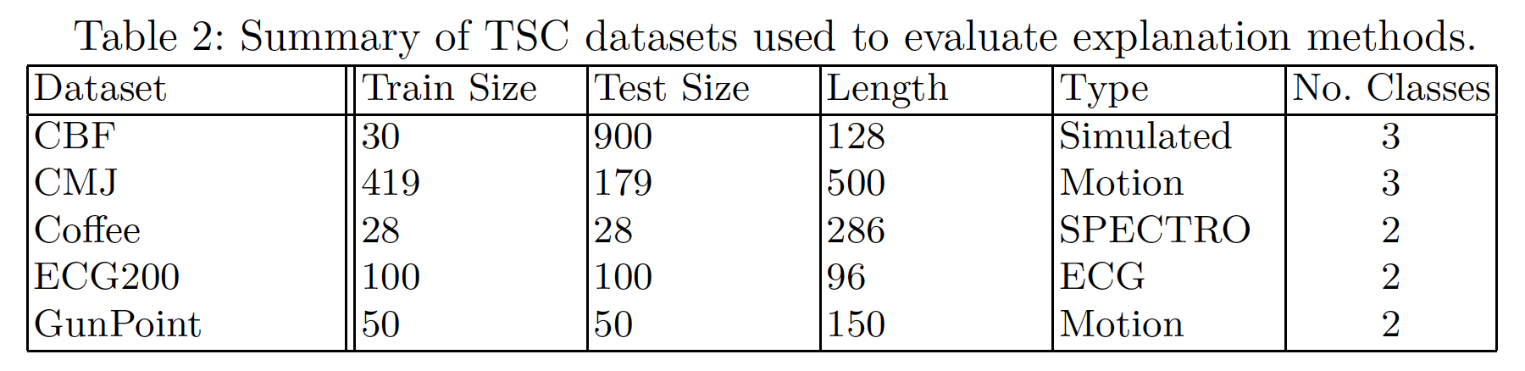
Experiments
Datasets
Explanation Methods:
MrSEQL-SM
ResNet-CAM
MrSEQL-LIME
Referee Classifiers:
MrSEQL
ROCKET
WEASEL

Slide 15
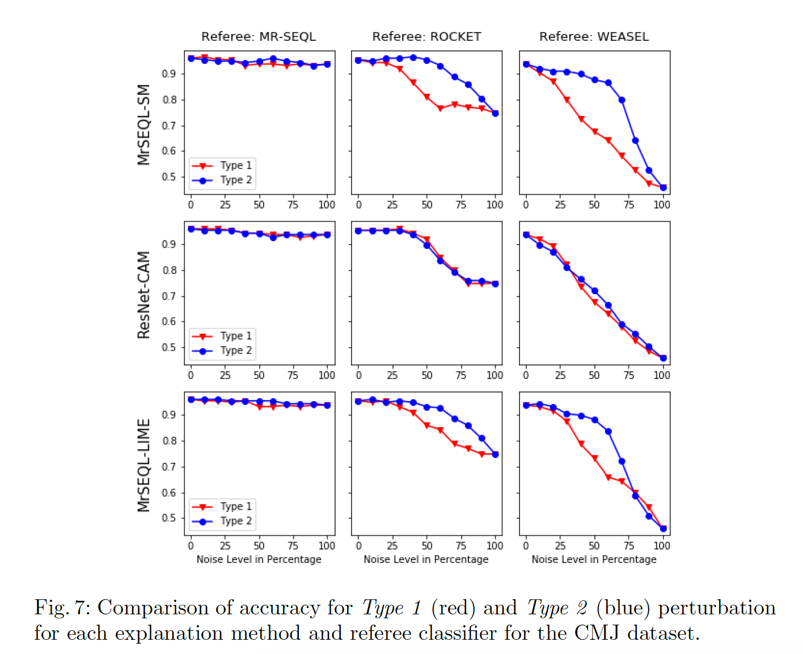
Experiments
Evaluate Single Method:
Type1 curve in red, Type2 curve in blue
Each row shows an explanation method and the accuracy of 3 referee classifiers for different levels of Type1 and Type2 noise
Explanation method is informative when the red curve is below the blue curve (loss in accuracy due to the explanation)

Slide 16
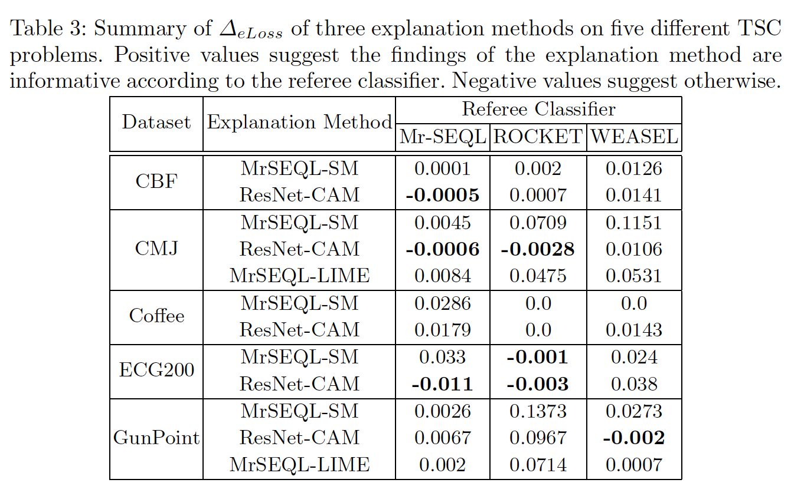
Experiments
Evaluate Single Method:
Method is informative when ΔeLoss >0
Notes:
Annotate figure for attention focus, maybe just focus on CMJ
2 aspects: is a given explanation informative? How does it compare to the other explanations (is it the most informative, where does it rank)?

Slide 17
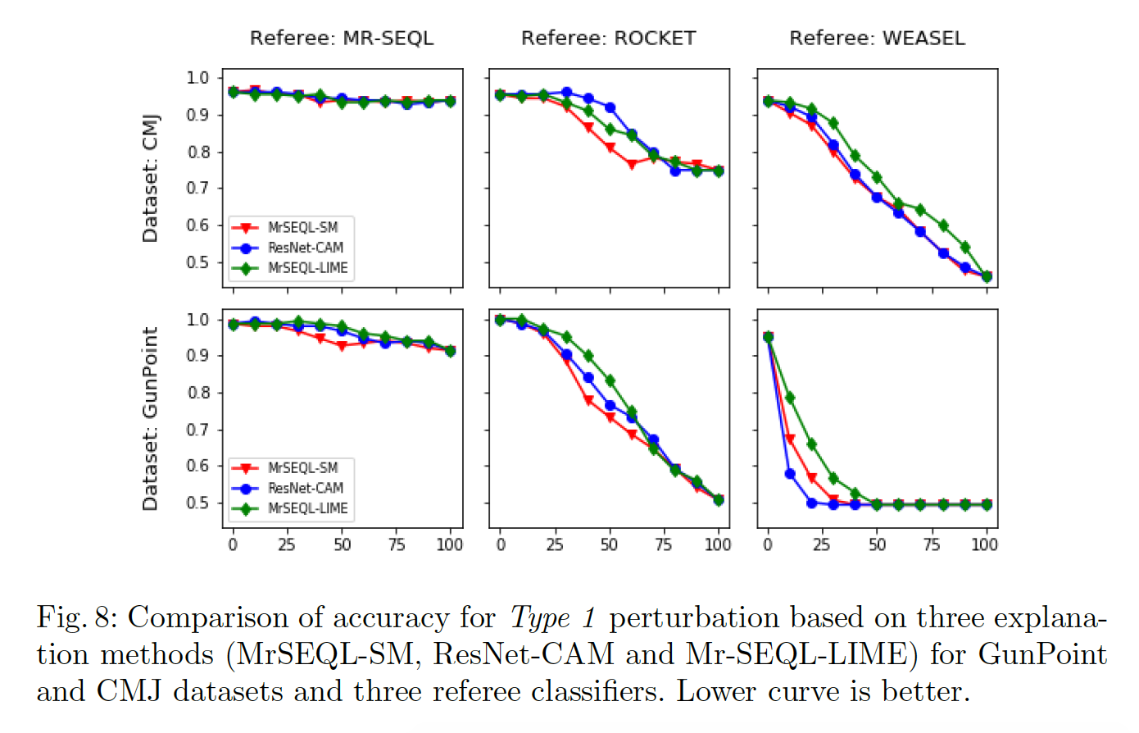
Experiments
Evaluate Multiple Methods:
Most informative method has the lowest (most impacted) explanation curve plotted by accuracy of referee classifier

Slide 18
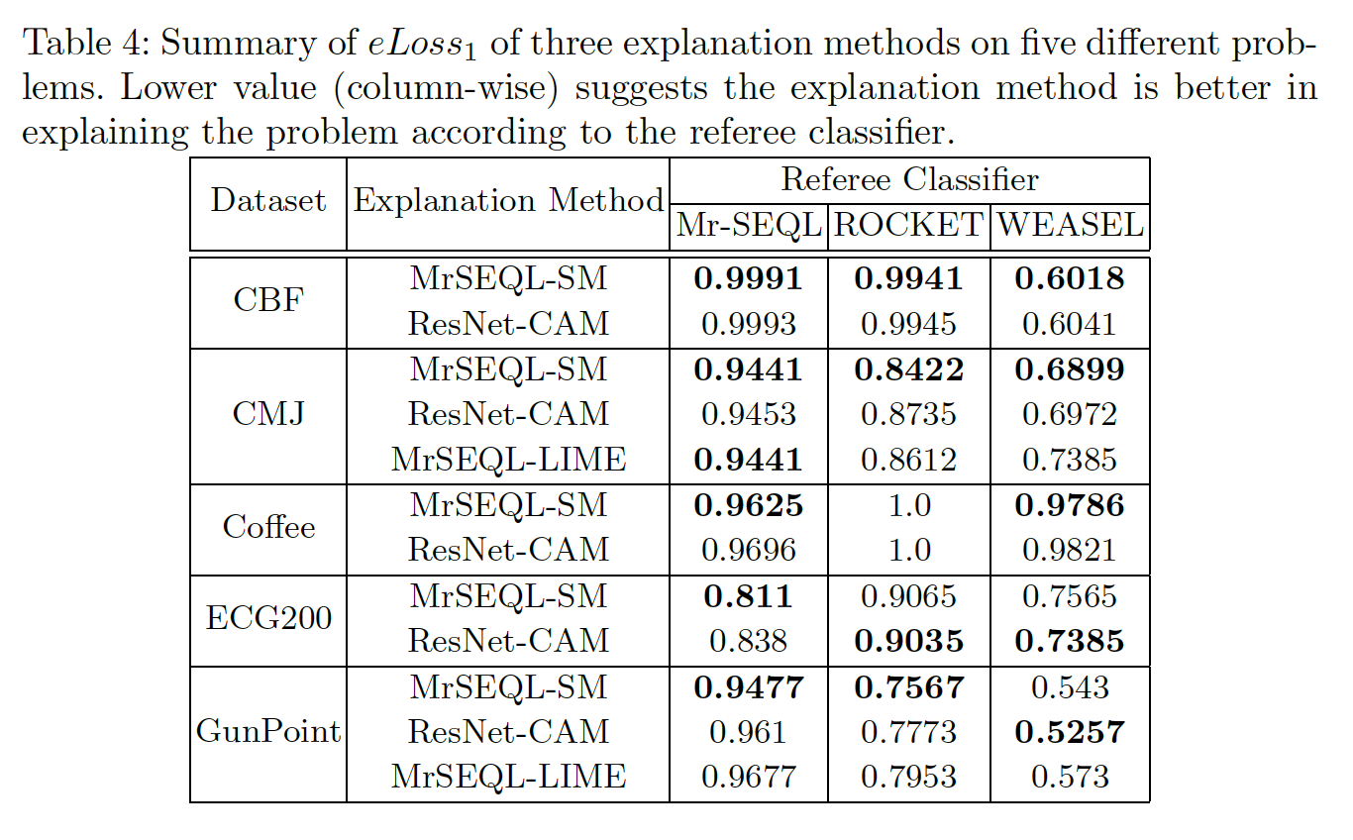
Experiments
Evaluate Multiple Explanation Methods:
Notes:
Add annotations, box, etc to focus the attention
add a note near the table anout what the number is, and that lower is better here (bigger loss induced by explanation)

Slide 19
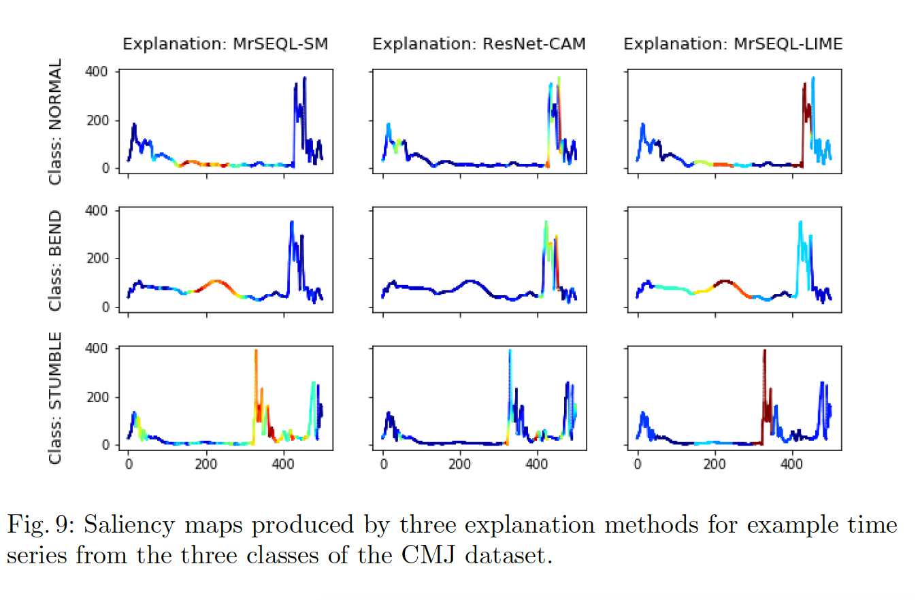
Experiments
Sanity Check for Experiment Result
MrSEQL-SM explanation is the most informative according to the quantitative estimation and also the qualitative sanity check. The qualitative result is confirmed by a domain expert in sports science.

Slide 20
Conclusions
It is possible to quantitatively evaluate the informativeness of explanation methods
Key ingredients: a set of explanation methods, explanation-driven perturbation, referee classifiers, explanation-driven loss in accuracy
The sanity check step (qualitative assessment) confirms the experiment result (quantitative assessment)
Use cases
Our approach enables a user to assess an existing explanation method in the context of a given application or to evaluate different explanation methods and opt for one that works best for a specific use case.
Our method can be used to filter a set of potential explanation methods before conducting expensive user-studies.

Slide 21
Future Work
Other perturbation approaches
Gaussian noise vs. Centroid-based
Other comparison benchmarks - lower/upper bound on informativeness
Compare Type 1-2 vs. Compare Type 1-Random SM
Use more/diverse referee classifiers
Detangle the robustness to noise from impact of explanation
Quantify other XAI properties in the context of TSC
Coverage, stability, and more
Notes:
Add: Acknowledgement: funding ack + Thank you + Any questions? + add slides with Ack!
Questions:
Why is this useful ? Any potential use case ?
How do you choose a referee classifier ? Any requirements for a referee classifier ?
Mr-SEQL as a referee isn’t independent !
Mr-SEQL+LIME vs Mr-SEQL+SM seems to be an interesting comparison. Do you have more insight ?
What if the referee classifiers disagree ? Majority voting?
What about the magnitude of eLoss and delta eLoss ? Are the numbers in the tables high or low ? Is there an upper bound/ lower bound ?
How do you validate the results ?
Can this method be used to evaluate a specific explanation ? A bad classifier can still accidently produce a good explanation.
It’s believed that the quality of explanation tied to the accuracy of the model. This method seems like a roundabout way to connect these two aspects. Why is this better than just looking directly at the accuracy?
How is the mapping from classifier to explanation done? Eg how do you obtain saliency weights from a model?
There seems to be an assumption that saliency maps are comparable between classifiers. Are you certain ?

Slide 22

Acknowledgements
This work was funded by Science Foundation Ireland through the SFI Centre for Research Training in Machine Learning (18/CRT/6183), the Insight Centre for Data Analytics (12/RC/2289 P2) and the VistaMilk SFI Research Centre (SFI/16/RC/3835).
Q&A
Notes:
Add: Acknowledgement: funding ack + Thank you + Any questions? + add slides with Ack!
Questions:
Why is this useful ? Any potential use case ?
How do you choose a referee classifier ? Any requirements for a referee classifier ?
Mr-SEQL as a referee isn’t independent !
Mr-SEQL+LIME vs Mr-SEQL+SM seems to be an interesting comparison. Do you have more insight ?
What if the referee classifiers disagree ? Majority voting?
What about the magnitude of eLoss and delta eLoss ? Are the numbers in the tables high or low ? Is there an upper bound/ lower bound ?
How do you validate the results ?
Can this method be used to evaluate a specific explanation ? A bad classifier can still accidently produce a good explanation.
It’s believed that the quality of explanation tied to the accuracy of the model. This method seems like a roundabout way to connect these two aspects. Why is this better than just looking directly at the accuracy?
How is the mapping from classifier to explanation done? Eg how do you obtain saliency weights from a model?
There seems to be an assumption that saliency maps are comparable between classifiers. Are you certain ?

Slide 23
References
[1] Ribeiro, M.T., Singh, S., Guestrin, C.: "Why should I trust you?": Explaining the predictions of any classier. CoRR abs/1602.04938 (2016), http://arxiv.org/abs/1602.04938
[2] Le Nguyen, T., Gsponer, S., Ilie, I., O'Reilly, M., Ifrim, G.: Interpretable time series classification using linear models and multi-resolution multi-domain symbolic representations. Data Mining and Knowledge Discovery 33(4), 1183{1222 (Jul 2019). https://doi.org/10.1007/s10618-019-00633-3
[3] Zhou, B., Khosla, A., A., L., Oliva, A., Torralba, A.: Learning Deep Features for Discriminative Localization. CVPR (2016)
Notes:
Add: Acknowledgement: funding ack + Thank you + Any questions? + add slides with Ack!
Questions:
Why is this useful ? Any potential use case ?
How do you choose a referee classifier ? Any requirements for a referee classifier ?
Mr-SEQL as a referee isn’t independent !
Mr-SEQL+LIME vs Mr-SEQL+SM seems to be an interesting comparison. Do you have more insight ?
What if the referee classifiers disagree ? Majority voting?
What about the magnitude of eLoss and delta eLoss ? Are the numbers in the tables high or low ? Is there an upper bound/ lower bound ?
How do you validate the results ?
Can this method be used to evaluate a specific explanation ? A bad classifier can still accidently produce a good explanation.
It’s believed that the quality of explanation tied to the accuracy of the model. This method seems like a roundabout way to connect these two aspects. Why is this better than just looking directly at the accuracy?
How is the mapping from classifier to explanation done? Eg how do you obtain saliency weights from a model?
There seems to be an assumption that saliency maps are comparable between classifiers. Are you certain ?

Slide 24
Related Work
Time Series Classification State-of-the-Art Algorithms vs Explainability
Methods | Examples | Explainability
Nearest Neighbor + Distance measure | 1NN-Euclidean/1NN-DTW | Case-based
Shapelet-based + Linear Classifier | Shapelet Transform, Learning Shapelets | Intrinsic
Dictionary-based + Linear Classifier | SAX-VSM, MrSEQL, ROCKET | Intrinsic
Ensembles | HIVE-COTE, BOSS, TSCHIEF | Post-hoc
Deep Learning | ResNet, FCN, InceptionTime | Post-hoc

Slide 25
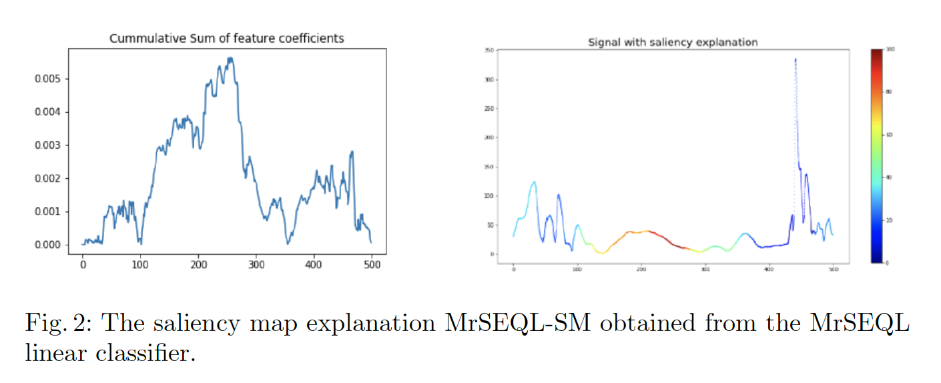
Related Work
Saliency Map (SM): Explanation for Time Series Classification
a visualisation approach to highlight parts of a time series that are important for the TSC model in making a prediction.
produced by matching a time series with a vector of weights (explanation) using a heatmap.

Slide 26
Related Work
Explanation in Other Domains:
Computer Vision (mostly saliency-based explanation)
Class Activation Map (CAM)
Gradient-weighted Class Activation Map (Grad-CAM)
Guided Backpropagation (GBP)
General: Local Interpretable Model-Agnostic Explanations (LIME)
Explanation Assessment:
Work by (Adebayo, 2018) attempts to visually and statistically evaluate the quality of a few saliency-based methods by tracking changes of the SM when the model parameters and test labels are randomized (qualitative assessment).
Not much work on quantitative assessment of explanation methods for TSC
Notes:
Add a paper reference here

